Slide 1
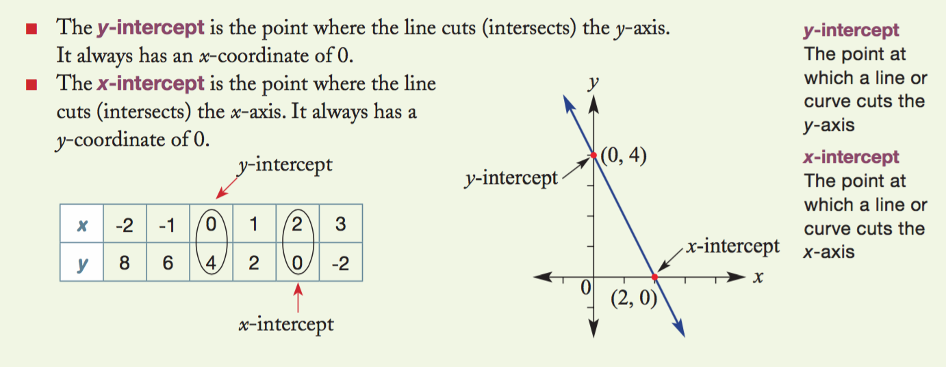
Year 10 Revision Lesson 1
Linear, Parallel and Perpendicular and point of intersection

Slide 2
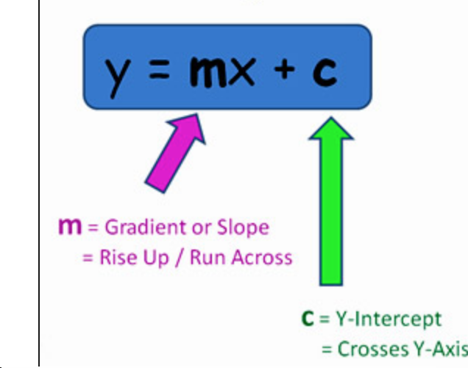
Linear Equations
What are Linear equations and what do the letters “m” “x” and “c” mean
Linear equations are in the standard form of y=mx+c
M= gradient
C = y-intercept
Y= a vertical axis value
X= a horizontal axis value
Occasionally, linear equations are written in the forms of f(x) = mx+c, where f(x) means the function of “x”.

Slide 3
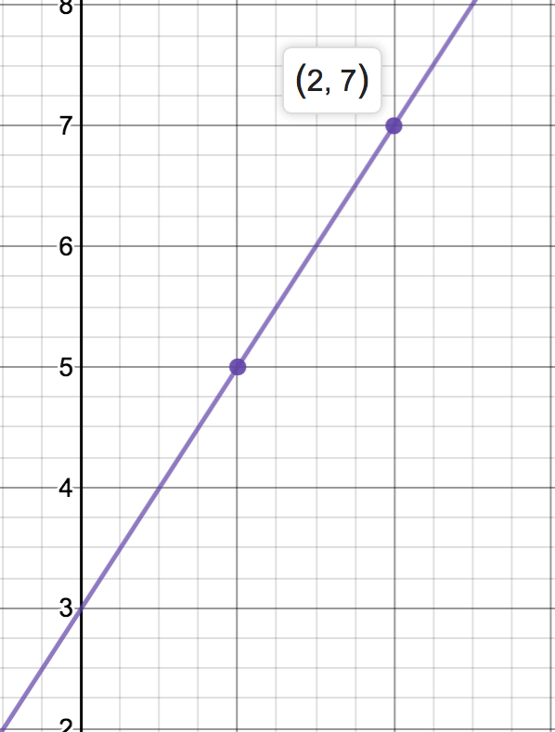
“C” – y intercept – where x always = 0
What are Linear equations and what do the letters “m” “x” and “c” mean
The C value in a standard form linear equation is the vertical intercept.
What it does is adjust the line upwards when ”C” is positive, and downwards when “C” is negative.
The easiest way to find the Y intercept is to look at the y-axis and determine the point of intercept.
If the line does not pass through at a whole number, you can find the Y-intercept algebraically.
Algebra – the gradient of a line is 2, and the point (2,7) is on the line.
Make an equation : y=2x+c
Sub in line point: 7= 2(2)+c
Solve like normal: 7 (-4) = 4 + c (- 4)
Answer: 3 = c. Therefore the Y intercept is 3.
We can see the y-intercept is 3, using graphing software.

Slide 4
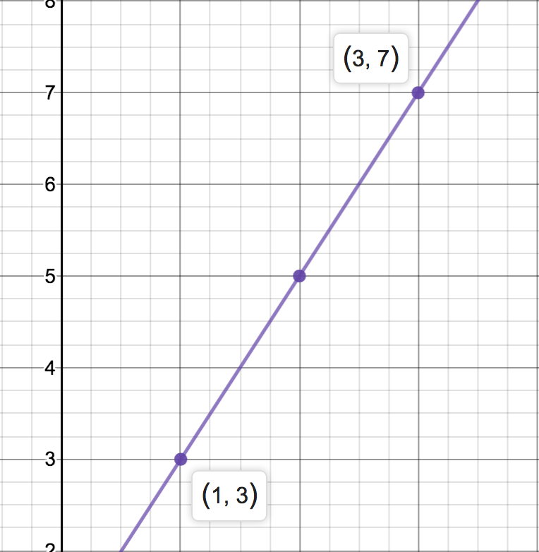

“M” – Gradient – rise over run
What are Linear equations and what do the letters “m” “x” and “c” mean
The gradient of a line is also called Slope.
Slope is the change in height divided by the change from left to right.
Gradient can be positive (up to the right) or negative (down the right)
A Gradient can be found buy substituting two points on a line like so : $\frac{y_{2 } − y_{1}}{x_{2} −x_{1}}$. Remember that points are given as (x,y)
Example Question: Two points (1,3) and (3,7) are on a line. Find the gradient of the line
Label the two points 1 and 2 – 1=(1,3) and 2=(3,7)
Subtract the first points from the second: (7-3) / (3-1) = (4/2) -> 2/1 -> 2, therefore 2 is the gradient
The line below shows the gradient of 2

Slide 5
Standard Form
What are Linear equations and what do the letters “m” “x” and “c” mean
Standard form of a linear equation is y=mx+c
Sometimes, the questions will not be given in this form, and you will need ot rearrange the problem to standard form.
This video will show us how to rearrange a formula to standard form:
https://www.youtube.com/watch?v=3OcGX817cOI
Have a go at rearranging these two equations: “y – 4x = 6” and “3y -18 =12x”
“y – 4x = 6” ,
move the 4x, and remember – change side, change sign – y=6+4x,
swap the order – y=4x + 6
“3y -18 =12x”
Notice all numbers can be divided by 3, so do that -> y – 6 = 4x,
Move the “6” across to the other side – CSCS→ y=4x+6

Slide 6
Review of linear - 3 minute quiz
Q1) What does the M in y=mx+c mean?
Q2) If a line slope goes up 6 spaces, and across 3 spaces, what is the gradient?
Q3) if a line has two points – (0,2) and (4,8) – what is the equation of the line?
1- M means Gradient
2- rise / run = 6 / 3, so the gradient is 2
3 – the point 0,2 is the y intercept, so C= 2. then rise over run is (8-2) / (4-0) = 6/4 or 3/2. putting it all together gives us “Y = 3/2x + 2”

Slide 7

How do you feel? Are there any holes in your understanding you need plugged? Are there some burning questions you may have?

Slide 8
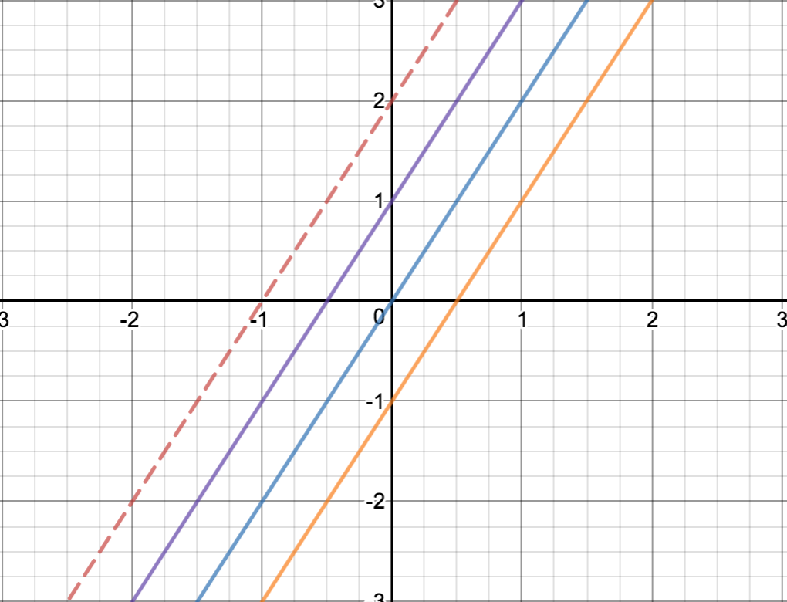
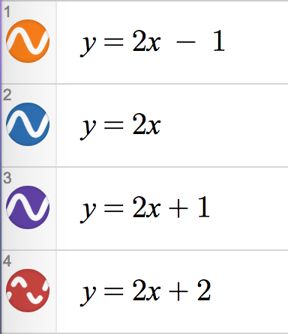

Parallel lines – Remember “m”
How do we tell if two lines are parallel?
The graph below shows how the same gradient with different “c” values still leave parallel lines
Parallel means that the distance between two lines is always constant.
We know that Linear equations are in the form of Y = Mx + C.
We also know “M” is the gradient (slope) of a line.
Thirdly, we also know that “C” is the Y-intercept, AND that it moves a line up and down the y axis.
So, how do we tell if two lines are parallel?
Given an equation – eg y=2x+3, we know that any line with a gradient of 2, will be parallel. So y=2x-3, y=2x+4, y=2x-1, y=2x+46.5 will be parallel.
Test your Skills: are these parallel or not?
y=2x + 4 and y=2x – 5.
y=$\frac{1}{2}$x + 5 and y=$\frac{2}{1}$x +4
y=$\frac{45}{2}$x -13 and y=$\frac{45}{2}$x =44
1) yes
2) no
3) yes

Slide 9
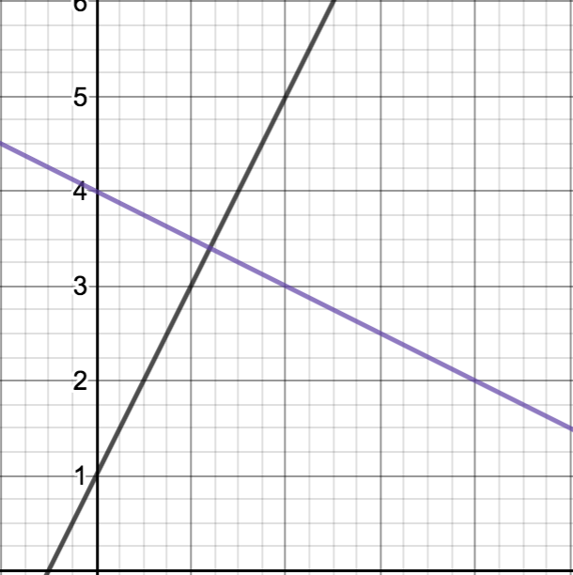


Perpendicular Linear Equations
What does Perpendicular mean, and how can we tell if two lines are Perpendicular?
Perpendicular means intersecting at a 90 degree angle, or making a tangent at 90 degrees to a line.
To determine perpendicular lines, the gradient needs to be flipped, and the sign changed.
Key things to note;
The number 2 is the same as the fraction $\frac{2}{1}$. 3 is the same as $\frac{3}{1}$.
The opposite of a positive number, is a negative number.
The reciprocal of a whole number is the flipped fraction, eg 2 is the same as $\frac{2}{1} ,$so the reciprocal is $\frac{1}{2}$. The opposite of $\frac{1}{2}$ is -$\frac{1}{2}$.
The perpendicular to a line with the gradient of 2, is a line with a gradient of - $\frac{1}{2}$.
We can see the lines with a gradient of 2 and a -$\frac{1}{2}$, and they form a 90 degree cross. The negative makes the line slope down to the right.

Slide 10
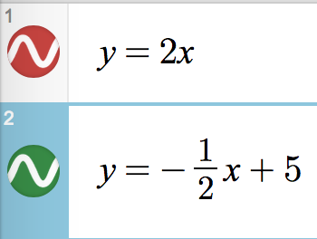
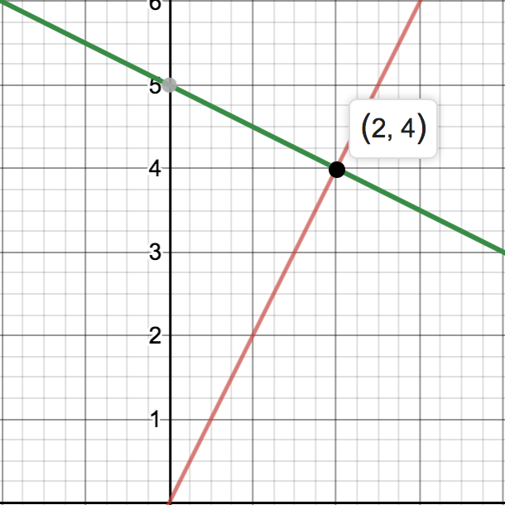
Point of intersection
Where two line cross, this is the point of intersections, and this is also called a solution.
From the equations below, an X value of 2 and a Y value of 4, will make both sided of the equation equal.
Proof? Substitute the Point of intersection into both equations (2,4)
What are Linear equations and what do the letters “m” “x” and “c” mean
RED 4 = 2(2)
4 = 4
GREEN 4 = -1/2(2) + 5
4 = -1 + 5
4 = 4

